Slide 1

Sentiment Analysis of Movie Reviews
Sai Manoj Karanam
Renee Suresh Manukonda

Slide 2
Motivation: Sentiment analysis is essential for grasping consumer emotions through textual data, particularly concerning movie reviews. These reviews significantly shape audience attitudes and business decisions. As advanced machine learning approaches, especially deep learning, become more prominent, there is a growing need for developing effective models that accurately classify sentiments in this field.
Project Overview: The aim of this project is to build a machine learning model that classifies movie reviews from the IMDB dataset as either positive or negative. The solution will involve thorough data preprocessing, establishing a baseline model, and developing more advanced models to improve sentiment classification accuracy. The objectives include optimizing the models and conducting a comprehensive evaluation using key performance indicators.
Introduction:

Slide 3

Problem Statement
The main challenge is to create a machine learning model capable of accurately classifying the sentiment of movie reviews as either positive or negative. This involves tackling complexities such as understanding context, handling language nuances, and choosing the most effective methods to enhance classification performance. Insights gained from exploratory data analysis since the project began have refined our strategies for preprocessing and model selection.

Slide 4
CHALLENGES
1. Computational Resource Constraints
Large Dataset: The IMDB dataset with 50,000 reviews posed a challenge due to its size.
RAM Issues:
Limited RAM on local machines made it difficult to process the entire dataset at once.
2. Training Deep Learning Models
Model Complexity: Models like BERT require significant computational power for fine-tuning and evaluation.
Training Time: Even with a GPU, fine-tuning BERT was time-intensive due to the size of the dataset and model complexity.
3. Text Preprocessing Challenges
Noisy Data:
The dataset included: Slang, typos, abbreviations and punctuation inconsistencies.
Solution: Robust preprocessing was applied to clean and standardize the data, including lowercasing and removing unnecessary punctuation.

Slide 5

Related Work
Purdue University Fort Wayne
The project is shaped by a review of existing literature on sentiment analysis, especially studies examining different machine learning algorithms and their applications in natural language processing. Research indicates that models like Naive Bayes, Support Vector Machines (SVM), Logistic Regression, Random Forest and BERT Model perform well in text classification tasks.
Naive Bayes is particularly noted for its efficiency and effectiveness in handling large datasets.
SVMs are recognized for their ability to manage high-dimensional spaces.
Logistic Regression offers a straightforward approach with interpretable results, making it a popular choice in various applications.
Random Forest, with its ensemble learning technique, provides robustness against overfitting and enhances predictive performance.
Recent advancements in deep learning have popularized models like BERT (Bidirectional Encoder Representations from Transformers). Pre-trained on large datasets, BERT effectively captures word context and relationships, making it ideal for complex sentiment analysis tasks. It outperforms traditional models in accuracy and generalization, guiding our focus on fine-tuning BERT for enhanced performance.

Slide 6
V
Purdue University Fort Wayne
Contribution:
Leveraged BERT for sentiment analysis, achieving higher accuracy and better generalization compared to traditional models like Naive Bayes, SVM, and Random Forest.
Focused on fine-tuning BERT to effectively capture contextual word meanings for improved classification.
Addressed computational challenges by optimizing resource usage with subset training.
Conducted a thorough evaluation using metrics like accuracy, F1-score, and ROC-AUC to validate performance improvements.

Slide 7
V
Purdue University Fort Wayne
Methodology/Proposed Approach
Data Preprocessing:
Processed the IMDB dataset by lowercasing reviews and removing punctuation.
Tokenized text using the BERT tokenizer, with padding.
Model Development:
Baseline Models: Implemented Naive Bayes, SVM, Logistic Regression, and Random Forest for initial comparisons.
Fine-tuned Naive Bayes: Enhanced performance by optimizing preprocessing steps.
Advanced Model: Fine-tuned BERT to capture contextual word meanings and improve binary sentiment classification.
Training Configuration:
Utilized GPU to train models effectively, addressing computational limitations.
Optimized Naive Bayes and refined text representations.
Model Evaluation:
Evaluated all models using metrics like Accuracy, Precision, Recall, F1-Score, and ROC-AUC.
Visualized results with:
Confusion Matrix for prediction analysis.
ROC and Precision-Recall Curves for classification thresholds.

Slide 8
V
Purdue University Fort Wayne
Data Acquisition, Preparation and Exploration
Data Source:
IMDB Dataset: contains 50,000 reviews (positive and negative).
Exploratory Analysis:
Review Lengths: Vary from short (few words) to long (several sentences).
Word Frequency: Emotional and movie-related terms are key sentiment indicators.
Dataset Quality: Balanced sentiment distribution with no missing values.
Data Preparation:
Text Normalization: Converted text to lowercase.
Punctuation Removal: Removed unnecessary symbols.
Stopword Removal: Eliminated common stopwords for relevance.

Slide 9
ML Experiment Settings
Baseline Models:
Naive Bayes, SVM, Logistic Regression, Random Forest
Used TF-IDF Vectorization to convert text into features for these models.
Default Hyperparameters: Chosen for simplicity and benchmarking against advanced models.
Training and Testing:
Used IMDB dataset for initial training and validation due to computational constraints.
Ran experiments on GPU to accelerate BERT fine-tuning.

Slide 10
RESULTS - 1
MODEL NAME | ACCURACY | PRECISION +VE | PRECISION -VE | RECALL +VE | RECALL -VE | F1 +VE | F1 -VE
Naive Bayes (MultinomialNB) | 0.84 | 0.91 | 0.81 | 0.70 | 0.95 | 0.79 | 0.87
Support Vector Machine (SVC) | 0.81 | 0.76 | 0.81 | 0.81 | 0.81 | 0.79 | 0.83
Logistic Regression | 0.82 | 0.79 | 0.84 | 0.79 | 0.84 | 0.79 | 0.84
Random Forest | 0.78 | 0.73 | 0.82 | 0.77 | 0.79 | 0.75 | 0.80

Slide 11
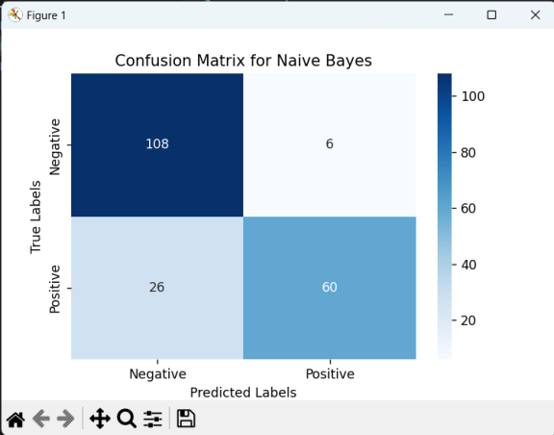
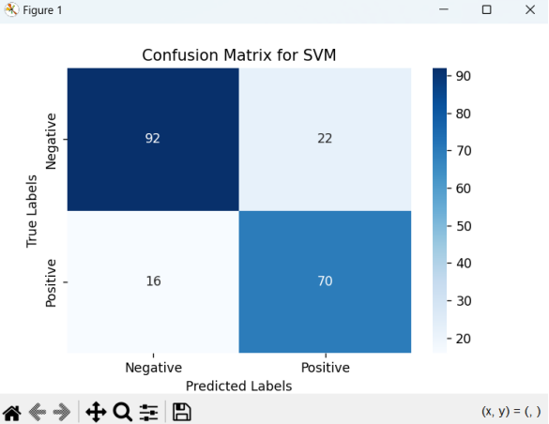
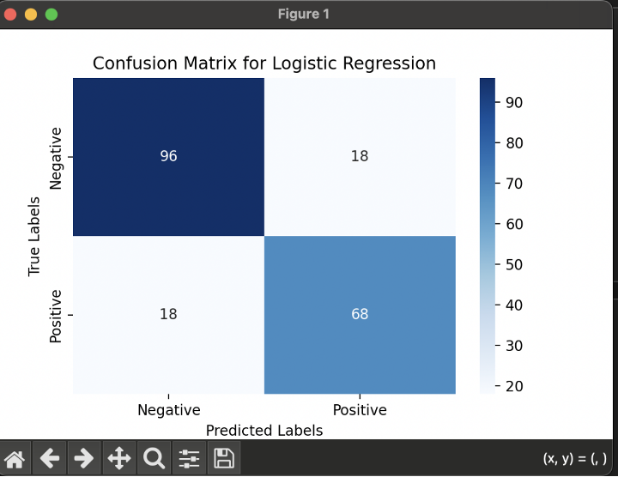
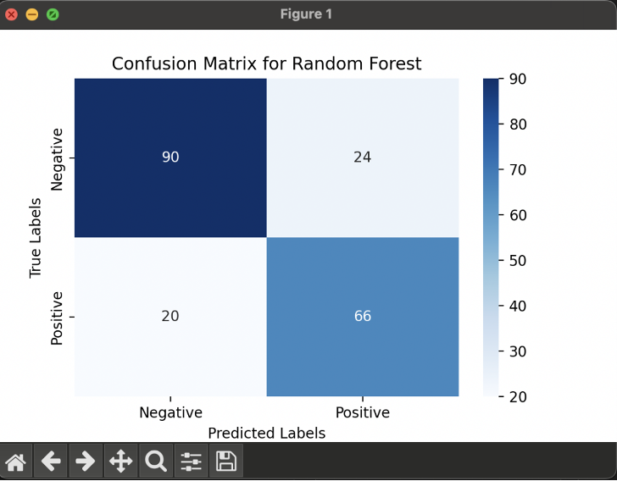

Slide 12
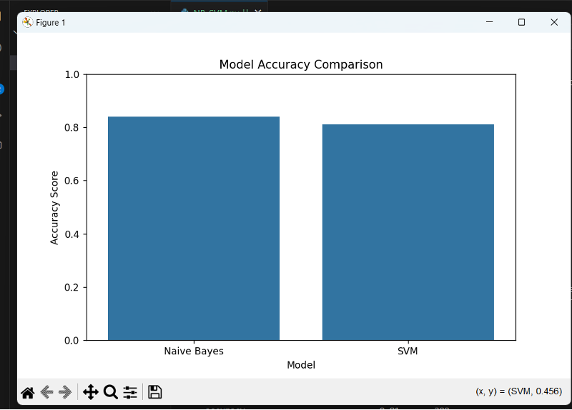
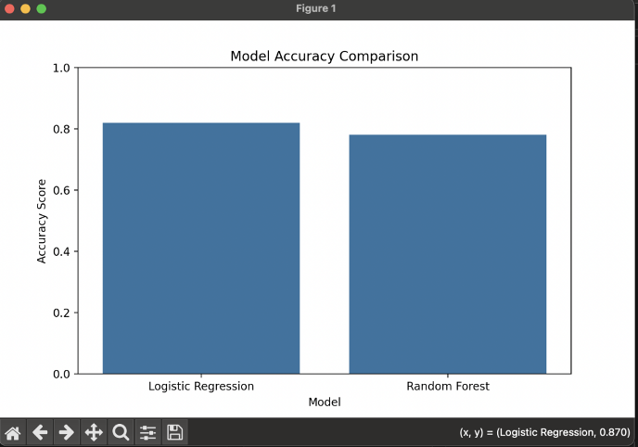

Slide 13
Naive Bayes:
Accuracy: 84%
Strength: Excellent precision for positive sentiments (91%).
Limitation: Struggles with capturing nuances, leading to low recall for positive sentiments (70%).
SVM:
Accuracy: 81%
Strength: Balanced precision and recall across both classes (76-81%).
Limitation: Computationally intensive, making it less practical for large datasets.
Logistic Regression:
Accuracy: 82%
Strength: Reliable and consistent with balanced precision and recall (79-84%).
Limitation: Has difficulty identifying complex patterns in text data.
Random Forest:
Accuracy: 78%
Strength: Resilient against overfitting due to its ensemble nature.
Limitation: Performs poorly on sparse text data, leading to lower overall performance.

Slide 14
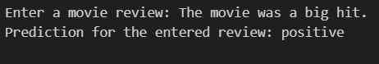
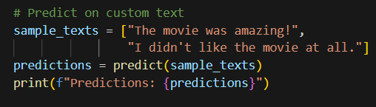
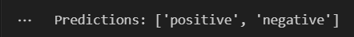
Results - BERT Model
Performance Metrics:
Accuracy: 86.75%
Precision:
Negative: 94%
Positive: 82%
Recall:
Negative: 78%
Positive: 95%
F1-Score: 87%

Slide 15
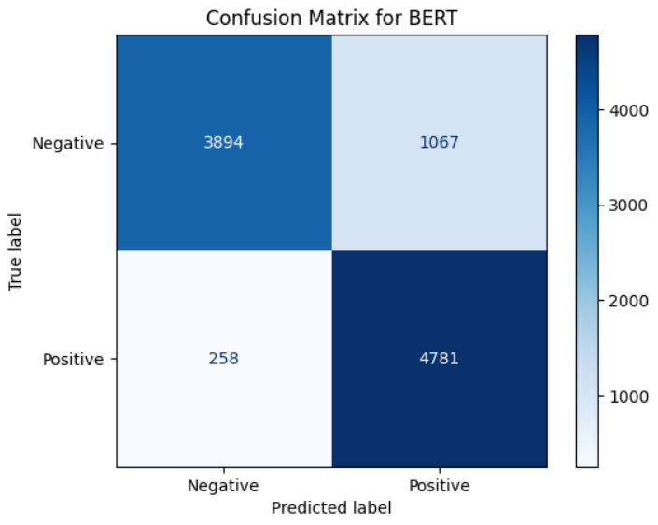
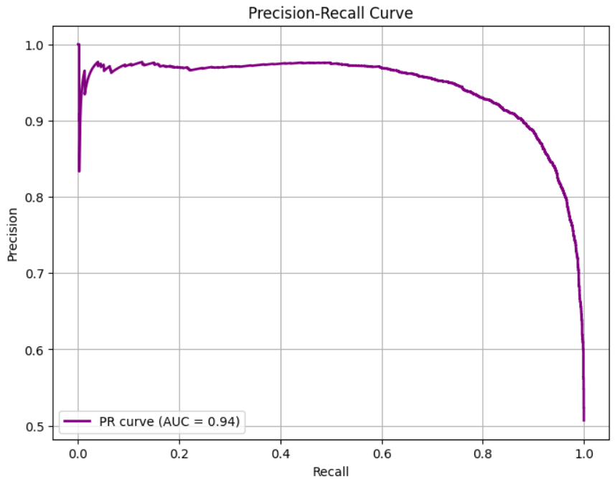
Results - BERT Model
Key Visuals:
Confusion Matrix: Highlights correct classifications and misclassifications.
Precision-Recall Curve: Consistent performance across thresholds.

Slide 16
Results - BERT Model
Insights:
BERT outperformed traditional models in accuracy and contextual understanding.
Most misclassifications occurred in predicting negative sentiment, likely due to ambiguous or short reviews.

Slide 17
Results - Naive Bayes Model
Improved Accuracy:
Advanced code achieved 86% accuracy, compared to 84% in the baseline.
Enhanced Preprocessing:
Added lemmatization, n-grams (unigrams + bigrams), and handled digits, resulting in better feature representation and context understanding.
Better Feature Extraction:
Increased feature set from 10,000 to 25,000 with optimized document frequency limits, capturing more meaningful patterns.
Balanced Dataset:
Used SMOTE to address class imbalance, improving recall for underrepresented classes.
Hyperparameter Optimization:
Conducted Grid Search CV for Naive Bayes, optimizing parameters for better generalization.
Performance Metrics:
Accuracy: 86%
Precision:
Negative: 84%
Positive: 87%
Recall:
Negative: 87%
Positive: 85%
F1-Score: 86%

Slide 18
Conclusion and Future work
Conclusion:
Successfully implemented and fine-tuned BERT for sentiment analysis of movie reviews.
Achieved 86.75% accuracy, outperforming traditional models like Naive Bayes, SVM, and Random Forest.
Visual metrics demonstrate strong model performance.
Addressed computational challenges by leveraging GPUs and using data subsets for initial experimentation.
Future Work:
Enhance Data Preprocessing: Incorporate advanced techniques like handling slang, typos, and context-based stopword removal.
Explore Larger Datasets: Use larger and multilingual datasets to improve model generalizability.
Fine-Tune More Models: Experiment with other transformer models like RoBERTa or DistilBERT.
Optimize for Deployment: Reduce model size and improve inference speed for real-world applications.

Slide 19


